Slide 1


Slide 2
Abstract
This document provides an insight on configuring bamboo server setup with a continuous integration methodology which can trigger deployment of builds as per build scheduled along with execution of pre-configured test scenarios post deployment of every development build.

Slide 3
What is Bamboo
Bamboo is an automation server used for Continuous Integration.
Developed by Atlassian in 2007, this tool allows the developers to automatically build, document, integrate, test the source code and prepare an app for deployment.
With Bamboo, you can ensure high quality and status, get end-to-end visibility into release implementation and spend maximum time writing the code rather than integrate various software.

Slide 4
What is Continuous Integration?
This is a software development methodology in which a build, unit tests and integration tests are performed, or triggered, whenever code is committed to shared repository multiple times in a day, to ensure that new changes integrate well into the existing code base.
Each check-in is then verified by an automated build, allowing teams to defect issues at the earlier stages.
With integration, issues can be detected quickly and will help them locate more easily.

Slide 5
Features of Bamboo
Commercial Software
Java Programming Language(license Terms)
Slightly Complicated
More user-friendly
Provides good online documentation
Has fewer plugins
Works on operating systems such as Windows, Linux, Solaris
It can be used on browsers such as Google Chrome, Mozilla Firefox, Safari, and
Edge.
Bamboo has around only 100 plugins in the Atlassian environment, as most of
the features are built in the Bamboo marketplace. However, this tool easily
integrates with Jira and Bitbucket when compared to other tools

Slide 6
Compatibility
Supports built-in JIRA software integration
Supports built-in GIT software integration
Supports built-in BitBucket server integration
Supports built-in deployment projects
Supports REST API
Supports test automation
Supports enterprise-grade permissions

Slide 7
Why Bamboo over other tools
Simple and intuitive drag & drop UI for designing Pipelines, based on the same tasks, jobs, stages principles of Continuous Delivery.
Supports temporarily disabling/re-ordering Stages, Jobs or Tasks
Separate Deployment manager helps easily manage deployment environments, track what is been released and where, and provide full traceability from a Release back to the Git commits and the JIRA issues it comprises.
Automatically detects new branches and builds them.
Seamless Integration of Bamboo with other Atlassian products
No plugins required for streamlining the process of merging Git and Mercurial branches.

Slide 8
Proposed Solution
Continuous Integration methodology is the proposed solution for all of the above mentioned disadvantages. Listed below are the features of the solution -
Developers will have access to the latest code base and all changes committed will be tracked via different tags which will help to identify incorrect files if any easily.
Build can be deployed in test environment based on the scheduled plan in the CI configuration without any manual intervention
Test automation, when integrated with continuous-build software, provides a collaborative and continuous build-and-test environment.
This practice is particularly of importance in an agile environment which can notify a developer for any errors as soon as a build/code is committed.
Increases the overall efficiency and effectiveness of developers and testers alike.`

Slide 9
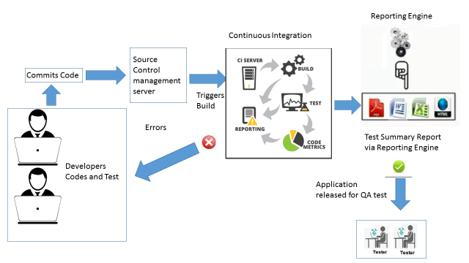
Proposed Solution Architecture and Guidelines

Slide 10
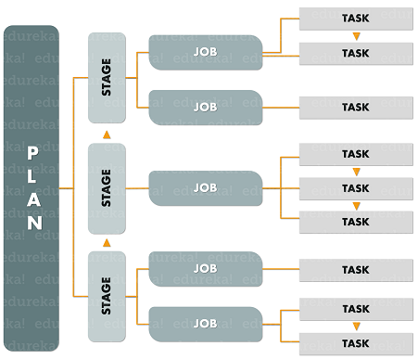
Bamboo architecture
In Bamboo, we have to create Plans, then set Stages, Jobs, and Tasks using the GUI. Refer below.

Slide 11
Thank you

